Slide 1
BitBox Hackathon 2021
Open-Source Learning Assistant AR
Team Jarvis2021

Slide 2
Technologies Used
Unity Engine
Augmented Reality(AR) SDKs like ARFoundation by Unity and ARCore by Google
Flutter SDK by Google
Data Analytics Plugin for ML Model
Flutter Unity Integration Plugin
C# and Dart Programming Languages

Slide 3
An Augmented Reality(AR) APP teaching Open-Source and Linux Concepts in a fun way
This AR APP(Open-Source Learning Assistant AR ) will be useful to anyone who is interested to learn about Open-Source Technologies and Linux kernel and mainly useful to children by teaching them these complex concepts in a fun way using Immersive Technologies like Augmented Reality(AR).
One can type some commands on the terminal which gets augmented into reality and can see what those commands do in AR

Slide 4
3. Our app presents users with a list of commands from which he can choose and learn the functionality of that command in a Terminal presented to him in Augmented Reality. If that command does not exist in the list of commands then our app redirect him to another scene where using Unity Web View feature one can browse about that command on the web.
4. We will even be analyzing the way user is using the APP, by storing the usage time on various sections, no of taps on screen which will tell whether the user is really learning or not and many more parameters, using all this data our ML model will analyze this and can predict the outcomes like with what pace user is learning, how much one has learnt, how much is one able to understand and much more.

Slide 5
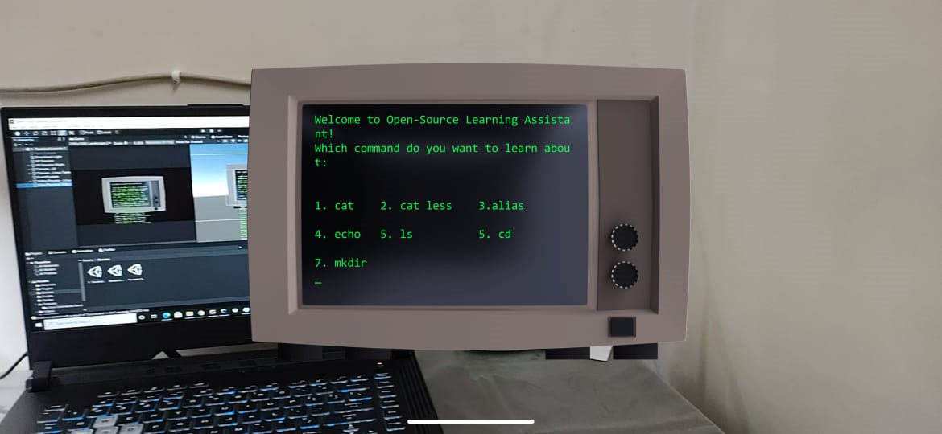
Working of Open-Source Learning Assistance APP in AR

Slide 6
Pictures of Project in Unity

Slide 7
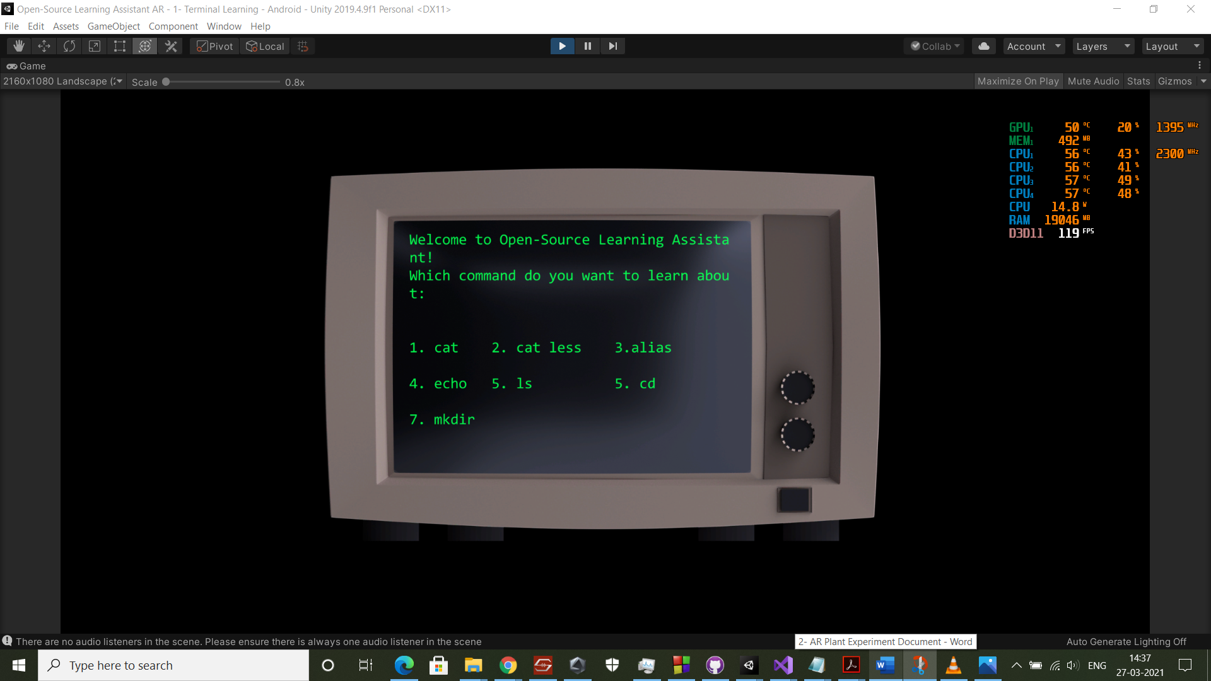

Slide 8
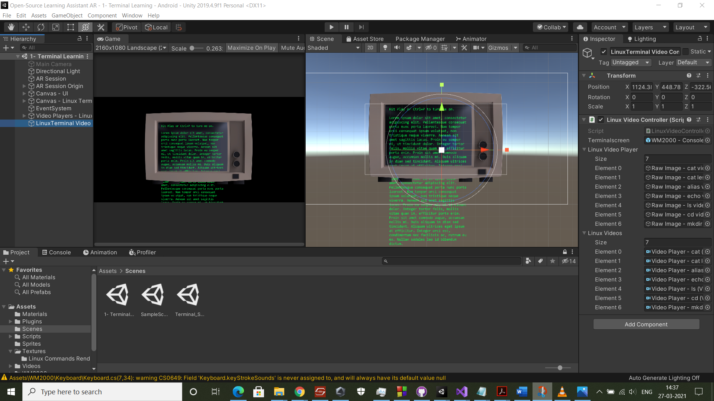

Slide 9
